Slide 1
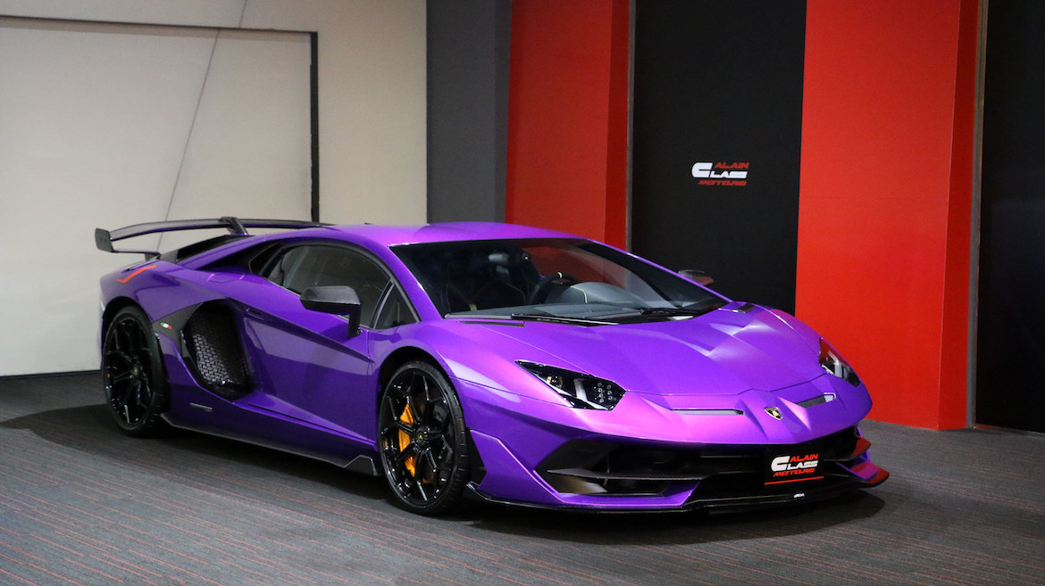
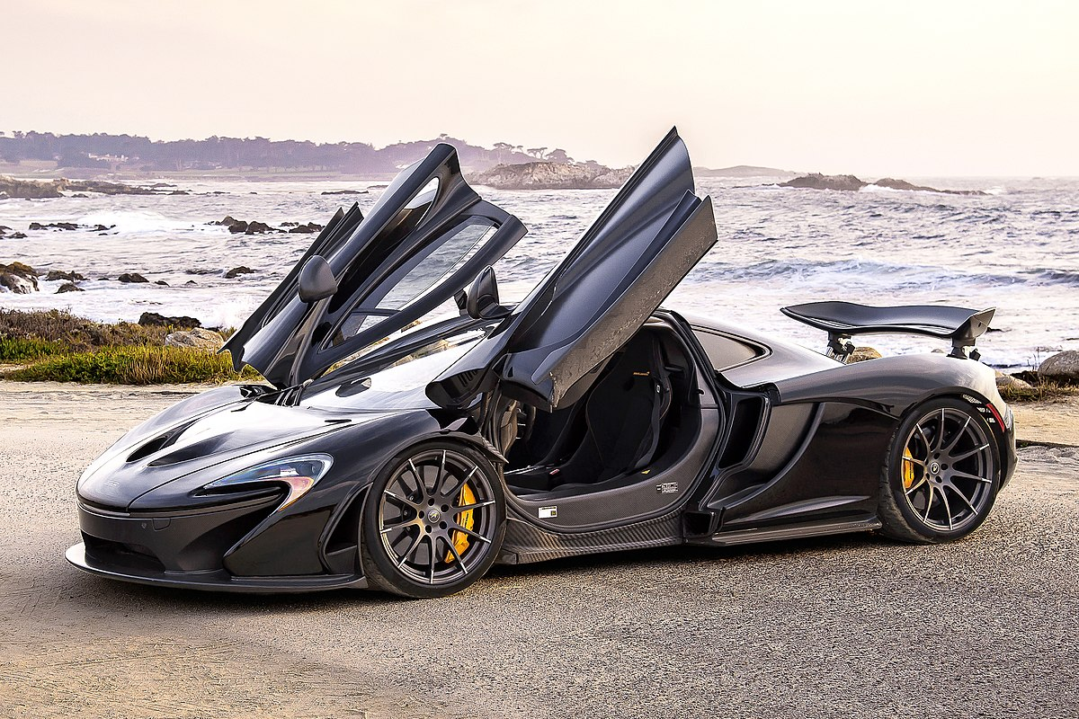
Car Dealership
Muhab E.
Comp-296

Slide 2
System objectives
Create Welcome screen for user friendly Interface
Based mostly on buying and car servicing
Create easy way to sign-up users
User search options by make, model, and year
Display data for specific cars
Schedule for servicing your car
Easy data entry through vehicle data look-up with vehicle id and display pics
Support for error handling and recovery
Data function(MySQL) saves both the car & driver information

Slide 3
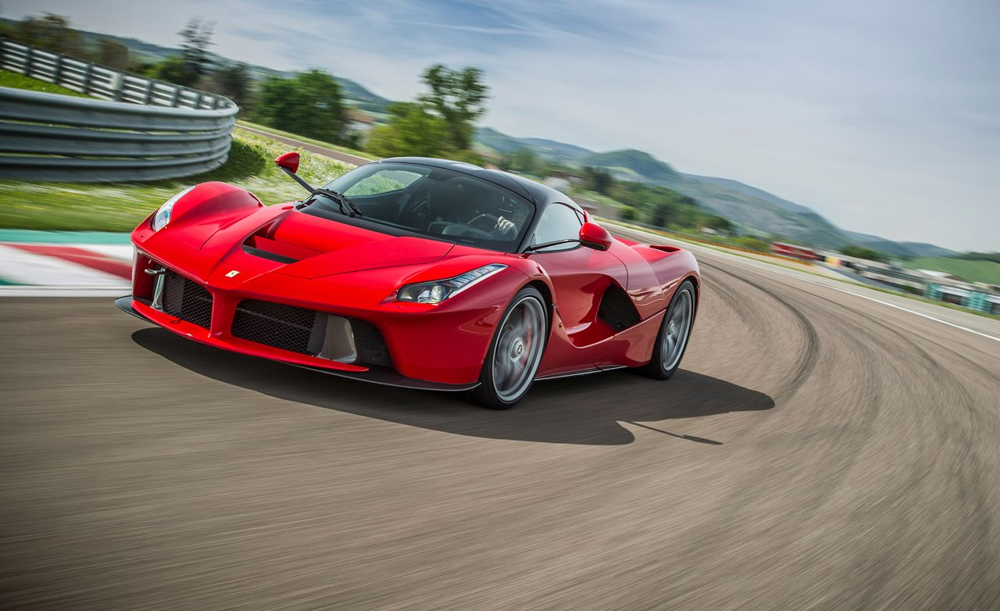
Development Software
Python
Pyqt5
Qt Designer
MySQL
phpMyAdmin (XAMPP)
Google
Firebase

Slide 4
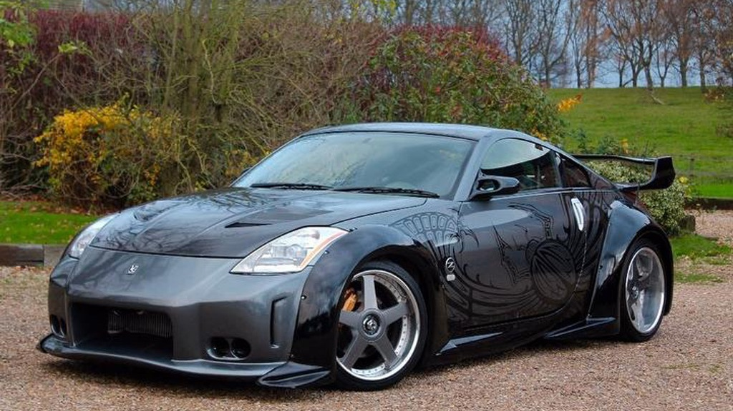
Implementation
Phase 1: Design MySQL database to store car and dealer data
Phase 2: Create initial GUI user layout
Phase 3: Connect database to GUI
Phase 4: Create GUI to register users
Phase 5: Allow user service request interface
Phase 6: Allow user search to search through car data
Phase 7: Connect different layouts together

Slide 5
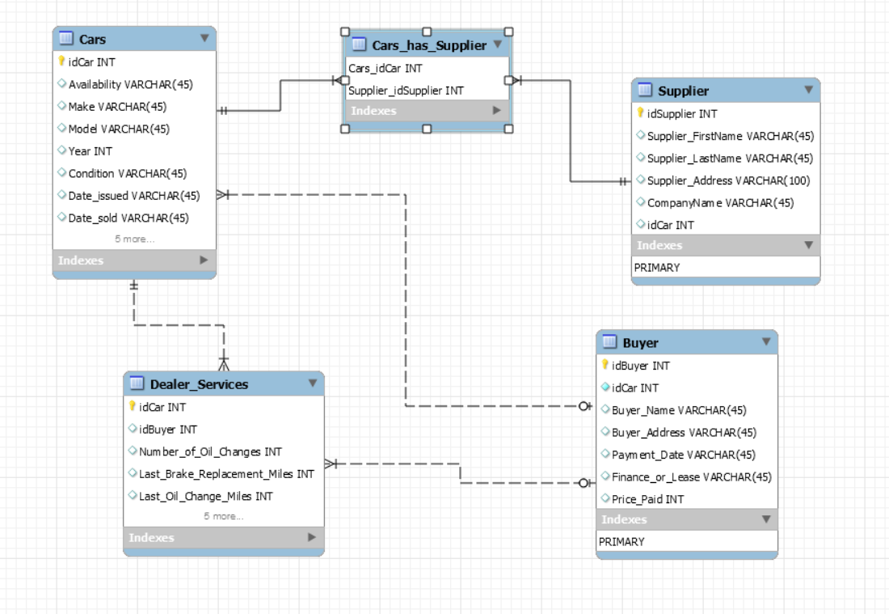
SQL Model Screenshot
Database Design

Slide 6
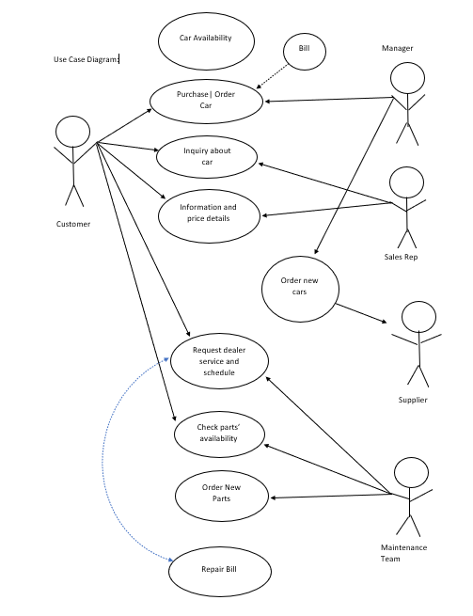
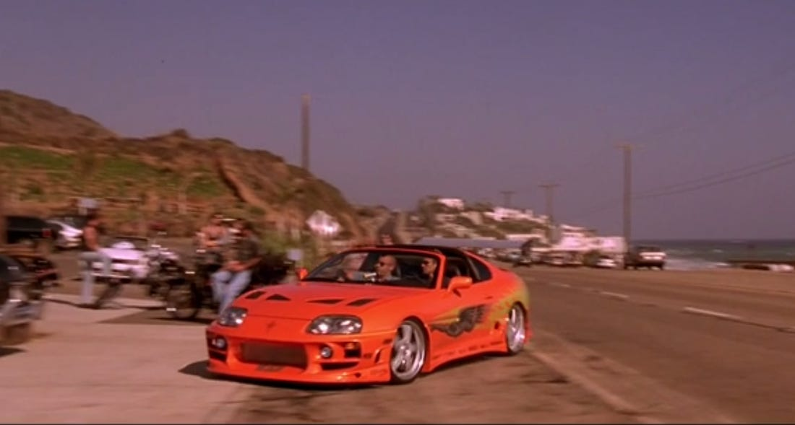
Use Case Diagram

Slide 7
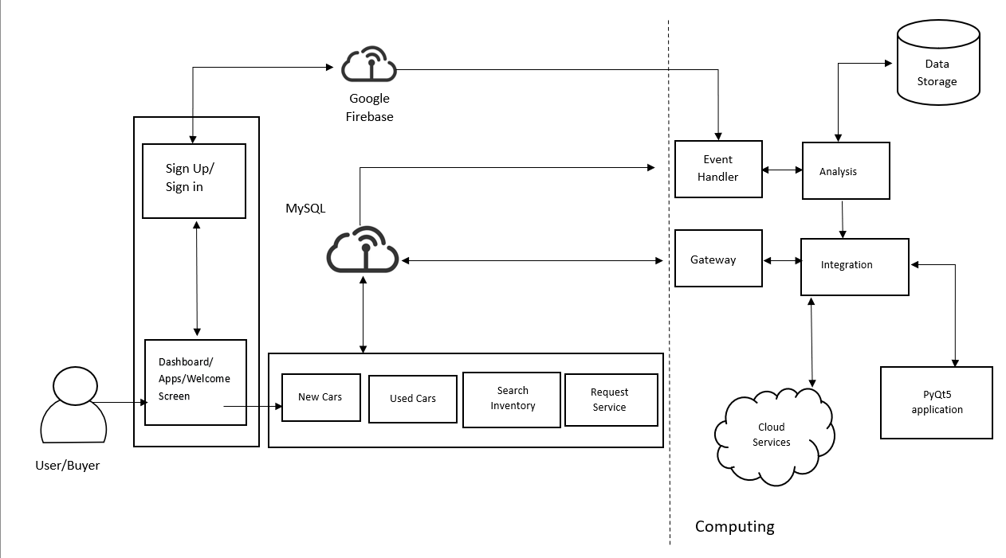
System Arch.
Start
Applications

Slide 8
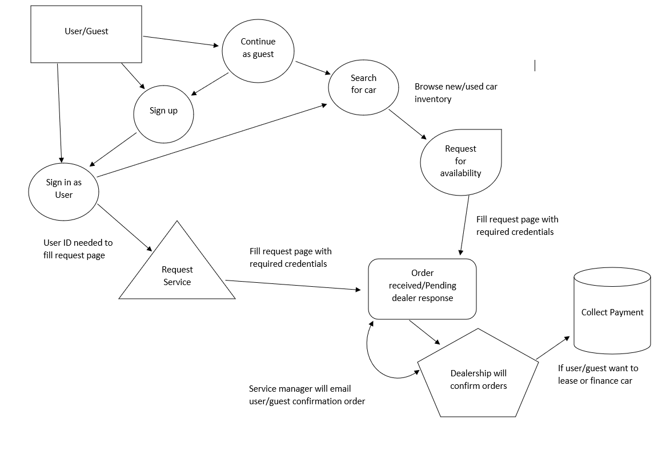
DFD

Slide 9
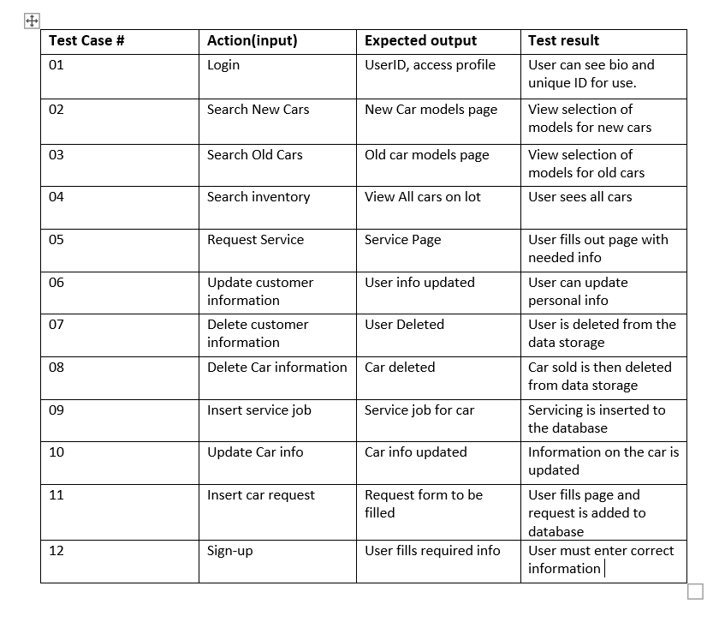
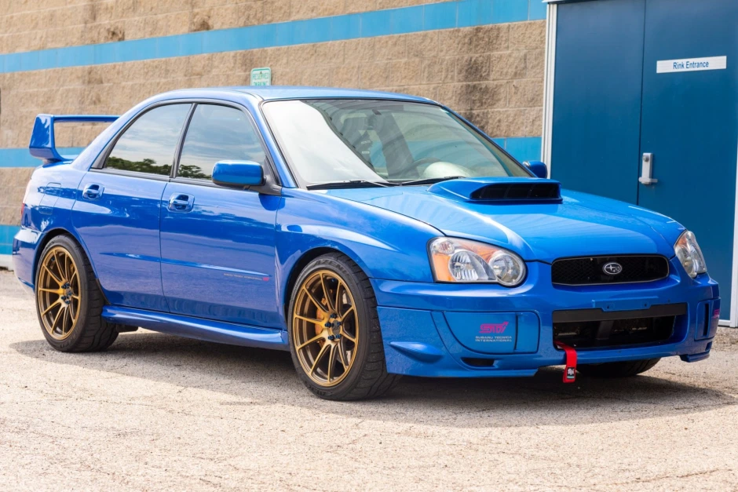
Test Cases

Slide 10
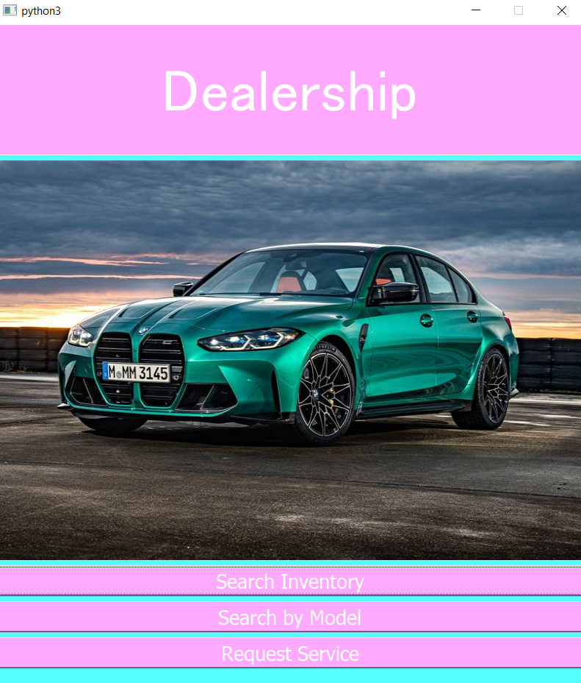
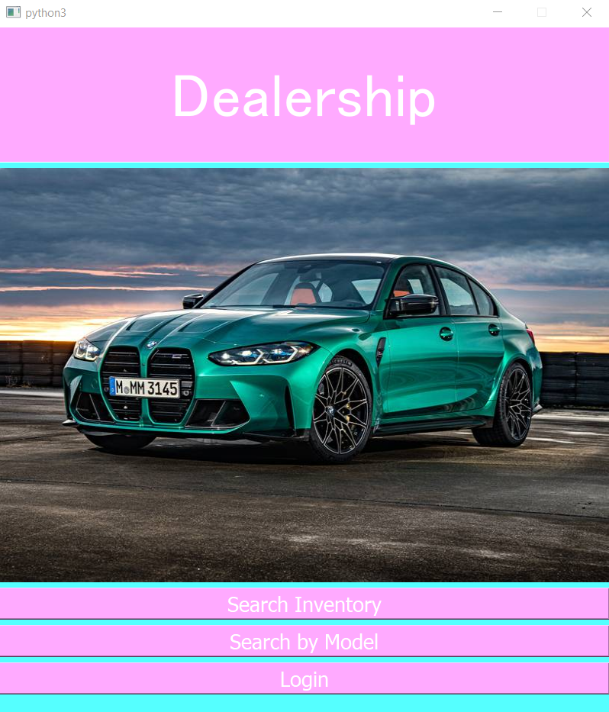
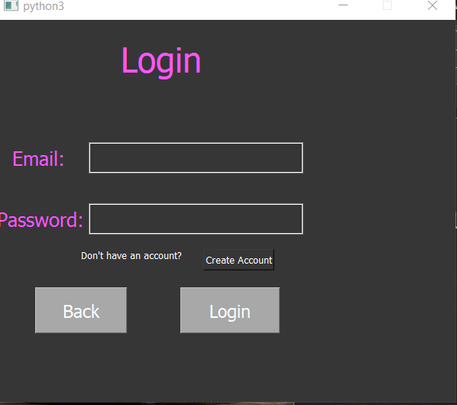
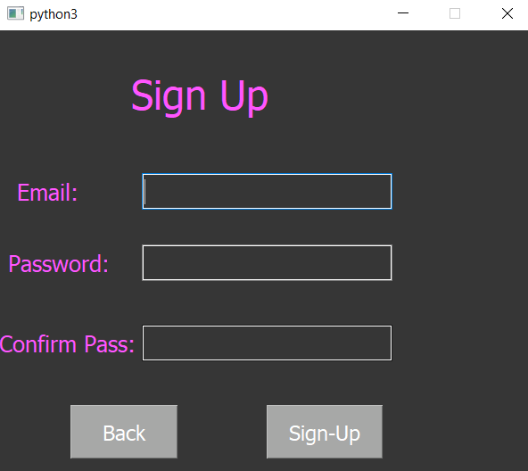
Screenshots

Slide 11
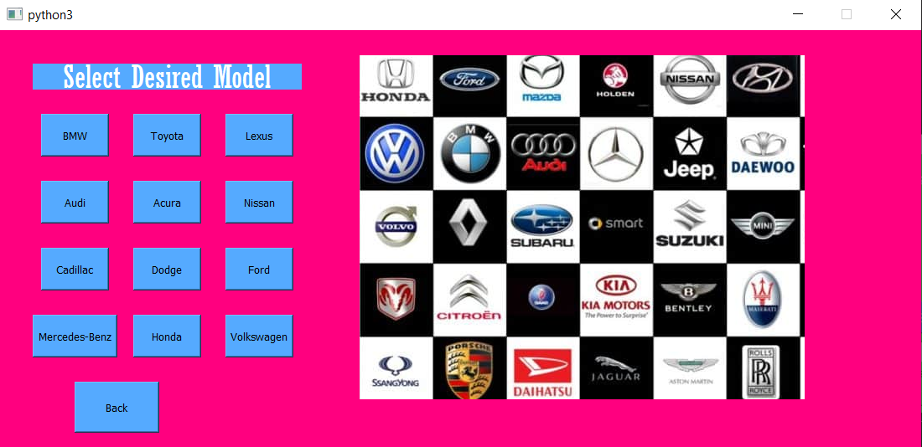
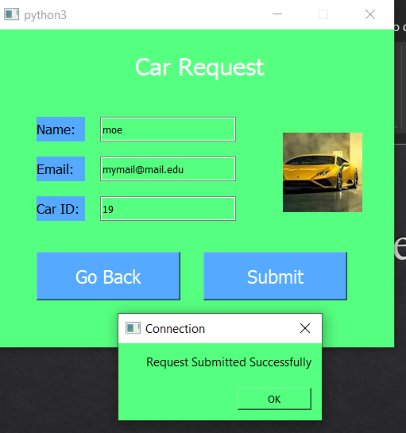
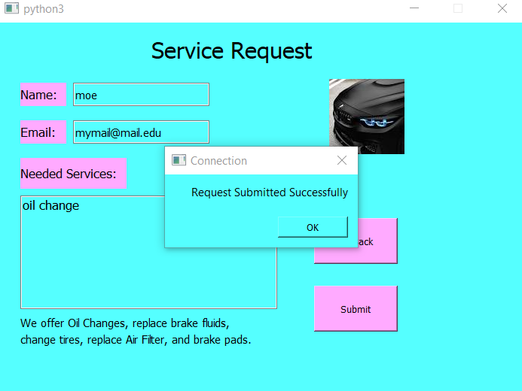
More Screenshots

